Slide 1


THE FUTURE OF DATA QUALITY:
CAN WE LET DATA FIX ITSELF?
What changes when an agent, not a rule, sits between the alert and the fix
Marcin Chudeusz · Co-Founder & CEO, digna
| Data Quality and Observability Platform
digna |
01
Notes:
TITLE — 0:00-0:30
Open with the question in the title rather than with yourself: 'Everyone here has been called because a number in a report was wrong. What I want to answer today is how much of that job a machine can now do without us.'
45 minutes: 5 introduction, 5 terminology, 5 for the DAMA Wheel, 25 for the nine dimensions, 5 to close.

Slide 2

Notes:
SPONSOR SLIDE — mandatory
Data Community Poland require the sponsorship slide; their template itself is optional. This is their artwork as supplied.
Fifteen seconds: thank the sponsors and move on. Not part of the 45-minute budget.

Slide 3
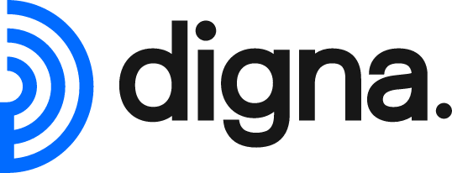
Agenda
Agenda
01
Introduction
5 min
Who I am and what digna does
02
Terminology
6 min
Data Quality, Data Observability, Autonomous Data Quality
03
What is changing
9 min
Data products, orchestration, and the agents arriving on top
04
Five triggers at Alpenwing
18 min
What an agent actually does with each one, and where it stops
05
The Steward, the limits, the horizon
7 min
What gets more interesting, and what never automates
| Data Quality and Observability Platform
digna |
03
Notes:
AGENDA — 4:00-5:00
Say the timings out loud. Flag that the whole dimension block runs on one worked example — an airline — so nobody has to re-orient nine times.

Slide 4
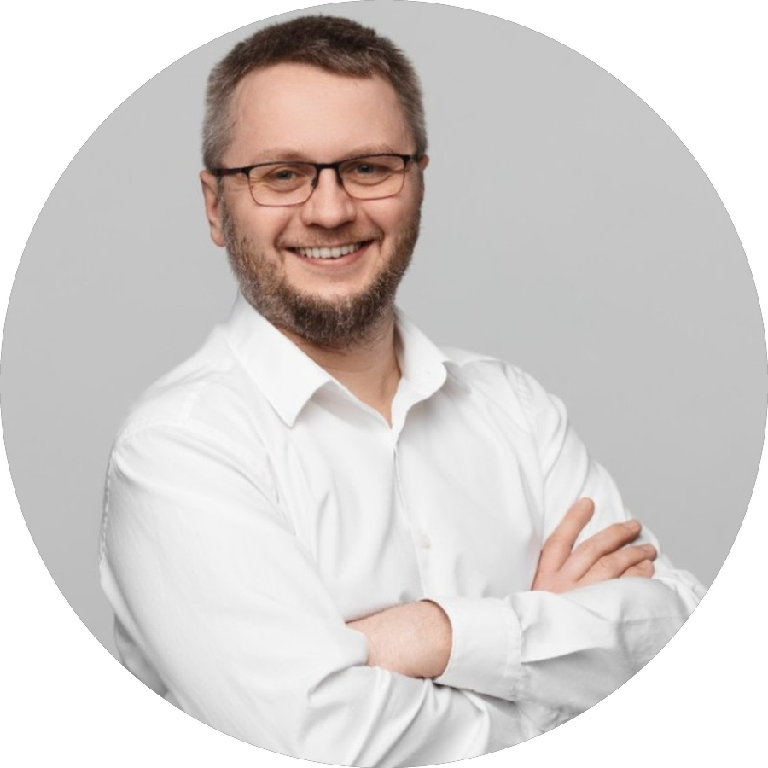
About me
Marcin Chudeusz
Living and working in Austria for 20 years
Studied at the Technical University of Warsaw
Focus throughout my career: data warehouses
Co-Founder & CEO of digna
Twenty years of building warehouses, and the same problem in every one: not performance, not modelling — trust.
| Data Quality and Observability Platform
digna |
04
Notes:
ABOUT ME — 0:30-1:45
Short and plain. Twenty years in Austria, degree from Warsaw, warehouses the whole way through.
The box at the bottom is the bridge into the talk.

Slide 5
The company
digna
An Austrian software company. Data Quality and Data Observability.
Learns instead of asking
Runs where your data is
Light enough to cover everything
digna profiles your data and learns what normal looks like. No manual thresholds.
In-database execution. Nothing is copied out — cloud or on-premise.
Fast, small ML models. Coverage across every table, not just a chosen few.
We cover every Data Quality dimension DAMA defines.
| Data Quality and Observability Platform
digna |
05
Notes:
DIGNA — 1:45-3:00
Three sentences, not a sales pitch. For a technical room the two things that matter are in-database execution and the absence of manual thresholds.
The bar at the bottom is the only sales sentence in the deck.

Slide 6
The company
digna modules
It began as a single idea. That idea became one module — the rest grew around it.
Data Anomalies
Data Analytics
Data Validation
Learns a table's normal behaviour and flags deviation.
Trends and volatility of the metrics themselves, over long periods.
User-defined rules at record level, fully auditable.
Timeliness
Schema Tracker
Data Reconciliation
Learned arrival patterns plus the schedules you declare.
Structural change: columns added, removed, re-typed.
In development — the same figures compared across systems.
Five modules today, one in development. You turn on what you need.
| Data Quality and Observability Platform
digna |
056
Notes:
MODULES — 3:00-4:00
One idea, one module, the platform grew around it. 'Modular' is the word to stress.
This is the last slide where digna is the subject. From here it is the airline.

Slide 7
Terminology
What is Data Quality?
The degree to which data is fit for the purpose it is used for — measured against an expectation somebody had to write down.
A property of the data
Relative to a purpose
Declarative
Values, keys, relationships. Not the pipeline, not the server.
A departure time good enough for a report is not good enough for a slot filing.
It only ever finds what somebody already thought of.
| Data Quality and Observability Platform
digna |
07
Notes:
DATA QUALITY — 5:00-6:15
The sentence to make stick is in the blue box.
The third column is the thesis of the whole talk. Rules have a hard ceiling — they find only what was anticipated.

Slide 8
Terminology
What is Data Observability?
The ability to understand the health and behaviour of your data from the signals it emits — without knowing in advance what will go wrong.
Freshness
Volume
Schema
Distribution
Lineage
When did this table last change?
How many rows arrived, against the norm?
Did a column change type or disappear?
Did the values inside the column shift?
What produced this, and what breaks downstream?
| Data Quality and Observability Platform
digna |
08
Notes:
DATA OBSERVABILITY — 6:15-7:30
The five pillars are the standard framing.
The key property: metadata-driven, no business input, therefore it scales to every table. Strength and limit at once — it says something changed, never that something is wrong.

Slide 9
Terminology
Two disciplines, not one
Data Quality
Data Observability
Question answered
Is this data correct?
Is this data behaving normally?
What is measured
The data values
The data and its metadata over time
Needs business input
Yes — someone states the expectation
No — baselines learned from history
Coverage
Deep on the tables you invested in
Broad across every table automatically
Finds
Known unknowns
Unknown unknowns
Blind to
Anything nobody wrote a rule for
Errors that look statistically normal
Neither contains the other. Autonomous Data Quality is the attempt to use the second to generate the first.
| Data Quality and Observability Platform
digna |
09
Notes:
COMPARISON — 7:30-8:45
The slide people photograph. Pause on it.
Walk the last two rows slowly. The example that defeats both, and we will meet it again: a block time of 92 minutes on a route that takes 148. Row counts normal, freshness normal, schema normal, value inside any global range — and wrong.

Slide 10
Terminology
What is Autonomous Data Quality?
The continuous, mostly AI-driven ability to detect, investigate, assess and remediate Data Quality issues with minimal human intervention.
Detect
Investigate
Assess
Remediate
Something moved far enough to be worth attention.
Which feed, which load, which column.
How bad it is and what depends on it.
Quarantine, hold, re-run — and record what was done.
Like Data Observability, it adapts. Thresholds and priorities follow the data instead of freezing on the day somebody wrote them.
| Data Quality and Observability Platform
digna |
10
Notes:
AUTONOMOUS DATA QUALITY — 8:45-10:00
Read the blue sentence word for word.
The four verbs separate this from tooling people already have. Almost every product stops after Detect.

Slide 11
The case
Alpenwing Airways
One airline and one flight leg — one take-off and one landing: WG 402, VIE (Vienna) → WAW (Warsaw Chopin), 12 February, tail OE-LGA. Every trigger later in this talk is that leg.
WG
VIE
62
94
11
IATA code
hub
aircraft
destinations
codeshare partners
Seven systems describe the same flight
PSS
DCS
AODB
AMOS
Crew
Revenue acc.
Partners
Passenger Service System · bookings
Departure Control · check-in, boarding
Airport Operational Database · times
Maintenance · fleet, fuel
Crew management · rosters
Revenue accounting · fares
Codeshare partners · eleven feeds
Nothing here is unusual. Every airline, bank and insurer has the same shape of problem: one real thing, seven systems, seven versions of it.
| Data Quality and Observability Platform
digna |
11
Notes:
THE CASE — 11:30-13:00
Introduce the airline properly, because the whole dimension block runs on it. Alpenwing is fictional but the shape is real: a mid-size European carrier with a mainframe-era policy system, an acquisition or two, and eleven partners who each have their own conventions.
The point of the seven boxes: no single system is wrong. They disagree because they were built for different jobs at different times, and the warehouse is where that disagreement becomes visible.
Say explicitly that we will follow one flight leg through all nine dimensions, and come back to it at the end.

Slide 12
What is changing
Two things are changing
at the same time
The data platform is changing shape, and agents are arriving on top of it.
| Data Quality and Observability Platform
digna |
12
Notes:
section_bg.png
logo_white.png

Slide 13
What is changing
From one warehouse to many data products
Before the agents arrive, the thing they operate on has already changed shape.
A central source of truth
Many data products, many owners
Everything landed in a warehouse owned by a team who agreed what a passenger was
A flights product, a revenue product, a loyalty product
Each source was checked as it arrived — but the data the warehouse produced from them, only at the end
Each with its own owner, contract and release cycle
A late source held up the whole load behind it
Quality has to hold at every boundary the data crosses, not just where it lands
Nobody owns the whole chain any more, so orchestration has to cover the gap.
| Data Quality and Observability Platform
digna |
13
Notes:
Start here, not with agents.
The warehouse as single source of truth is giving way to data products with their own owners and release cycles. That is already happening in most rooms like this one.
The consequence is the point: nobody owns the whole chain any more.

Slide 14
What is changing
What an agent needs from you
An agent does not need to be told how.
It needs to be told what, and how far it may go.
That is a different integration model from anything we have built before, and it is the part most teams have not priced in yet.
| Data Quality and Observability Platform
digna |
14
Notes:
Say the big line slowly. It is the hinge of the whole talk.
Everything we have built until now was an instruction for how. An agent takes what, and a boundary.

Slide 15
What is changing
Integration today, and what replaces it
The same reload, expressed two ways — and the difference is who does the work.
Today: you wire every call
Emerging: you state the intent
Find the stored procedure and its parameters
“Reload yesterday's boarding records for WG 402”
Find the source API, its auth, its rate limit, its paging
The agent finds the procedure and the API in the catalog
Write the retry, the ordering and the error handling
It sequences, retries and verifies the row count itself
Rewrite all of it when the partner changes their export
A changed export becomes a new plan, not a new sprint
We will spend less time specifying how a reload happens and more time specifying what may be reloaded, by whom, and without asking.
| Data Quality and Observability Platform
digna |
15
Notes:
This is the slide engineers in the room will argue with, so be concrete.
The left column is a fortnight of work and a maintenance burden forever. The right column is a sentence and a permission boundary.
Do not oversell it: the agent still needs the catalog to find the procedure.

Slide 16
How agents fit
What the agent reads,
and what it may change
Two separate questions, and the second one is where the risk is.
| Data Quality and Observability Platform
digna |
16
Notes:
section_bg.png
logo_white.png

Slide 17
How agents fit
An alert becomes work, not a queue entry
An alert no longer waits for somebody to read it.
It starts the work itself.
Today it lands in a queue and waits for Monday. What changes is that the finding arrives with its evidence attached, at something able to act on it.
| Data Quality and Observability Platform
digna |
17
Notes:
The shift is from queue to trigger.
Today an alert waits for a person. Tomorrow it arrives at something that can already do the first four steps of the investigation.

Slide 18
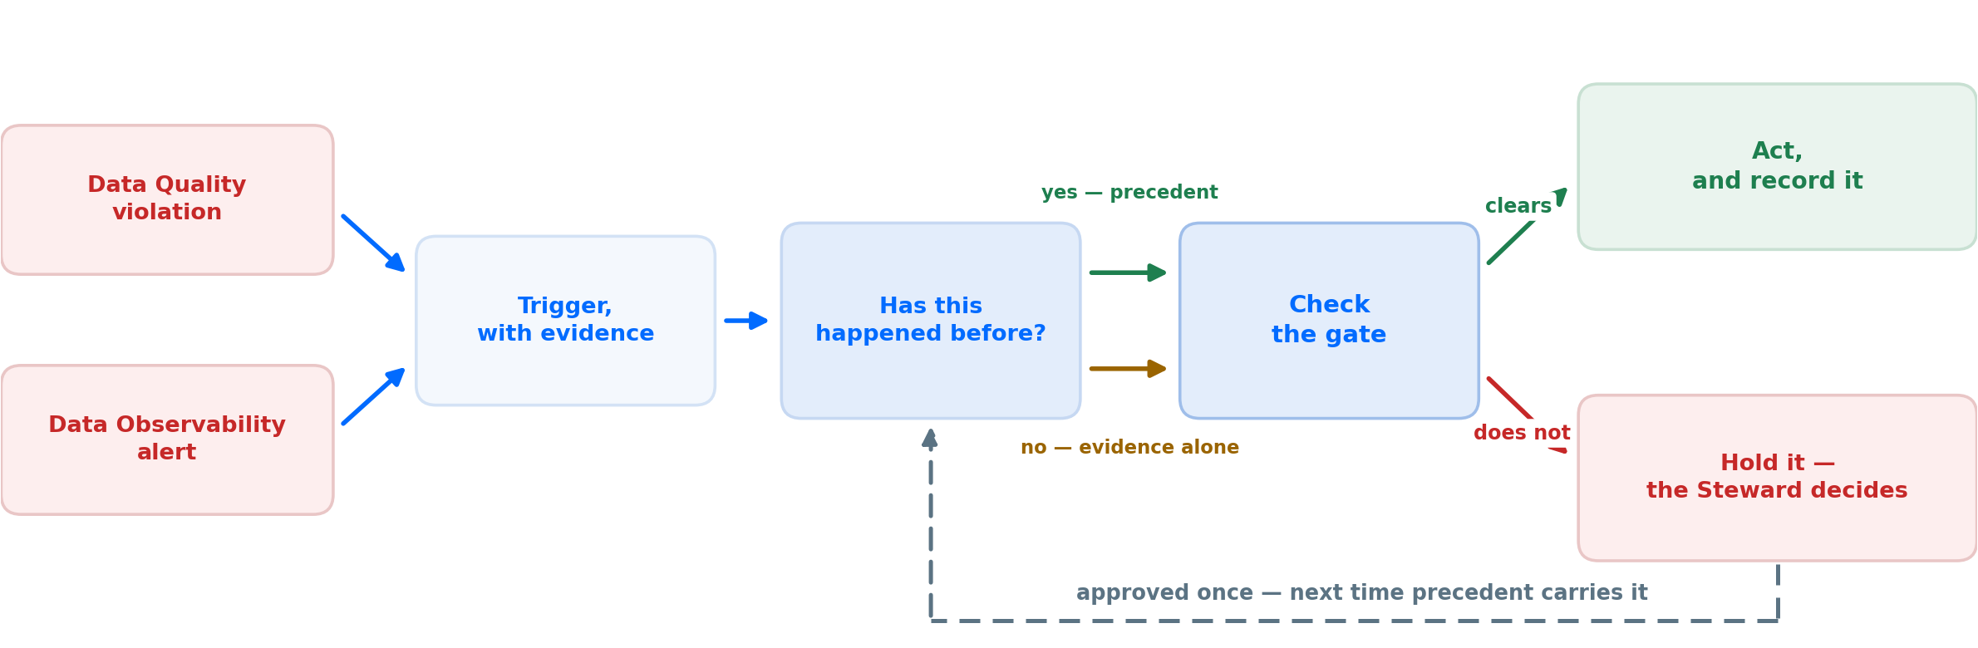
How agents fit
How an agent handles a finding
Every alert takes this path. Precedent makes it cheaper; the gate is what decides.
Precedent is an input, not a switch — it is neither required nor sufficient.
| Data Quality and Observability Platform
digna |
18
Notes:
Walk it left to right, once, slowly.
A violation or an alert becomes a trigger carrying its evidence. Then: has this happened before?
Both answers go to the same place. With precedent the gate is cheap to clear. Without it, the evidence has to carry the case on its own — an authoritative dated source, a reversible action, a small blast radius.
And precedent does not guarantee anything. A pattern approved for one mart does not clear the gate for a regulatory report.
The dashed line is what compounds: approved once, and next time precedent carries it.

Slide 19
How agents fit
Which sources the agent may trust
The agent can reach four kinds of source. They are not interchangeable, and the order it consults them in is part of the design.
Your knowledge base
check here first
The catalog, the lineage, the approved pattern library, the contracts. It knows what your columns are meant to hold and what was already decided — so it is the first place the agent looks, not the last.
Published registers
authoritative, external
IATA and ICAO codes, national aircraft registers, the IATA delay-code list. Dated, citable, and the change itself is published — the right second stop when the answer is not in-house.
The open internet
plausible, unverified
Useful for orientation and for explaining an unfamiliar value. Never sufficient on its own to justify writing to your warehouse.
The model's own memory
weakest of the four
An agent that says LOWW is Vienna without citing anything looks identical to one that looked it up. This is the tier nobody lists, and the one that causes the incidents.
Ask your own knowledge base first. An agent that cannot name its source does not get to act.
| Data Quality and Observability Platform
digna |
19
Notes:
This is the risk-assessment slide. Two things to land.
First the order: the agent asks your own knowledge base before it asks the outside world. The catalog knows what the column is meant to hold and the pattern library knows what was already decided — going outside first is how you get a confident answer to the wrong question.
Then the fourth tier, which is the one to dwell on. The open internet is orientation only.
The model's own memory is the weakest source and the one nobody lists, because an uncited answer looks exactly like a researched one.
Land it: an agent that cannot name its source does not get to act.

Slide 20
How agents fit
What decides whether it may act alone
Four questions, all of them checkable — and none of them is the model's own confidence.
01
02
03
04
Has this exact pattern been approved before?
Is the action reversible?
Is the source authoritative and dated?
How large is the blast radius?
A Steward approved LOWW → VIE once, so the tenth occurrence is a lookup rather than a judgement. The strongest single signal — and the agent can still act without it when the other three are unambiguous.
Quarantine, hold, re-request and reload can all be undone. Overwriting a value in place cannot. Reversible actions earn far more freedom.
A published register with a publication date justifies acting. A plausible answer with no citation does not, however confident it sounds.
One quarantined row is not the same as a dimension every mart joins to, which is not the same as a figure already filed with a regulator.
Precedent is neither required nor sufficient. Unambiguous evidence can carry a reversible action without it, and a wide blast radius stops it even with it.
| Data Quality and Observability Platform
digna |
20
Notes:
Expect pushback here, and welcome it.
Model confidence is not calibrated and this room knows it. That is why none of the four gates is confidence.
Precedent is the strongest: a pattern a Steward already approved.

Slide 21
How agents fit
How much freedom each data product gets
Identical agent, identical trigger, three different answers — because the organisation and the data are not.
A regulated bank
An airline's operations data
A marketing data product
Propose only, never apply
Reversible actions run alone
Most fixes run unattended
every action waits for a named approver
reload, re-request, quarantine, hold
the cost of being wrong is a bad segment
Full evidence chain retained
Irreversible ones are proposed
Escalate only on repeat
what it saw, what it read, what it decided
anything that overwrites in place
one glitch is noise, three is a pattern
Nothing touches reported figures
Safety data always escalates
Review weekly, in aggregate
a filed number is frozen, full stop
a load sheet is not a data problem
nobody reads these one at a time
The dial is set per domain and per data product, never once for the whole company.
| Data Quality and Observability Platform
digna |
21
Notes:
Freedom is configurable, per domain and per data product.
A regulated bank and a marketing mart do not get the same dial, and neither does safety data inside the same airline.

Slide 22
How agents fit
What happens when the agent is wrong
It will be. The question is only whether you can see it and undo it.
Every action carries evidence
Every action can be undone
Patterns are monitored too
What fired, and what it read
Reversible by construction
An approved pattern can go wrong
the alert, the register, the catalog entry
quarantine and hold rather than overwrite
the world moved under it
Which pattern it matched
One decision rolls back
Watch the rate, not the instance
and who approved that pattern, and when
not the day, not the load — the action
a pattern firing ten times more often
What it changed, exactly
Undo is itself recorded
Patterns expire
row-level, with the before value retained
including who reversed it and why
re-approval, not permanent permission
Without an audit trail you cannot tell a working agent from a broken one.
| Data Quality and Observability Platform
digna |
22
Notes:
The agent will be wrong sometimes. Say that out loud before anyone asks.
Evidence, undo, and monitoring of the patterns themselves.
The third card is the subtle one: an approved pattern can start misfiring because the world moved, not because the pattern changed.

Slide 23
How agents fit
Why this belongs in the platform
A general-purpose agent with database credentials is not the same thing as this.
Without the catalog
Without lineage
Without the pattern library
It does not know what a column means
It cannot scope a re-run
Every occurrence is the first one
is dest_city a code or a label?
which four reports consume this feed?
no precedent, so no autonomy
It cannot judge a domain
It restarts everything, or nothing
Nothing compounds
94 airports, or every string ever seen?
both are expensive
the tenth fix costs what the first one did
It guesses, and sounds certain
It cannot judge blast radius
The Steward never gets time back
the worst possible failure mode
one row, or the regulatory report?
which was the entire point
Without a catalog, lineage and approved patterns, a language model should not be near your warehouse.
| Data Quality and Observability Platform
digna |
23
Notes:
This is the digna argument, and it is an honest one.
A general-purpose agent with database credentials has no catalog, no lineage and no pattern library. It guesses, it cannot scope a re-run, and nothing it does compounds.

Slide 24
Alpenwing
Five triggers,
five different answers
One airline, one flight leg: WG 402, Vienna to Warsaw Chopin, 12 February, tail OE-LGA.
| Data Quality and Observability Platform
digna |
24
Notes:
section_bg.png
logo_white.png

Slide 25
Scenario 01 · The trigger
A partner feed switches from IATA to ICAO codes overnight
What fired
What the agent may reach
the trigger, not a ticket
and how far each source is trusted
Data Observability: average length of dep_airport moves from 3.00 to 4.00 overnight, on a single source
The pattern library
LOWW → VIE was approved by a Steward in March
Data Quality: 1,284 rows fail the allowed-set check, all from the same feed
The published ICAO register
authoritative, dated, and reversible without ambiguity
Nothing else on that feed moved — volume, nulls and arrival time are normal
The catalog entry for dep_airport
declared domain: IATA airport codes
Maturity
Close to today. Register lookup plus an approved pattern is the easiest case there is.
| Data Quality and Observability Platform
digna |
25
Notes:
SCENARIO 01 — THE TRIGGER
A partner feed switches from IATA to ICAO codes overnight
Left: what fired. Right: what the agent may read, and how far each source is trusted.
Maturity: Close to today. Register lookup plus an approved pattern is the easiest case there is.

Slide 26
Scenario 02 · The trigger
WG 402 boards 36 passengers onto a 180-seat aircraft
What fired
What the agent may reach
the trigger, not a ticket
and how far each source is trusted
Data Observability: load factor on VIE–WAW is 0.20, against a band that has not been below 0.72 in two years
The pattern library
‘reload a leg, then verify against a second source’ is approved
Data Quality: the leg fails the 50%-of-seats rule
The booking system, through its API
a second, independent count for the same leg
The rest of the day's legs are entirely normal
Lineage
three marts and the daily operations report consume this leg
Maturity
Close to today. The reload is a known procedure; the agent chooses when to call it.
| Data Quality and Observability Platform
digna |
26
Notes:
SCENARIO 02 — THE TRIGGER
WG 402 boards 36 passengers onto a 180-seat aircraft
Left: what fired. Right: what the agent may read, and how far each source is trusted.
Maturity: Close to today. The reload is a known procedure; the agent chooses when to call it.

Slide 27
Scenario 03 · The trigger
Departure Control counts 168 passengers on WG 402, the Airport Operational Database counts 171
What fired
What the agent may reach
the trigger, not a ticket
and how far each source is trusted
Data Reconciliation: the scheduled comparison between the two systems fails by three passengers
The pattern library
no approved pattern covers a definitional disagreement
Data Observability: nothing. Both feeds are on time, at normal volume, with normal distributions
Both systems, through their APIs
one query each — they are separate databases
168 is a normal number. 171 is a normal number. No metric moved at all
The catalog
and it does not define whether an infant on a lap is a passenger
Maturity
Where this goes. The agent does the analysis; the definition stays a human decision.
| Data Quality and Observability Platform
digna |
27
Notes:
SCENARIO 03 — THE TRIGGER
Departure Control counts 168 passengers on WG 402, the Airport Operational Database counts 171
Left: what fired. Right: what the agent may read, and how far each source is trusted.
Maturity: Where this goes. The agent does the analysis; the definition stays a human decision.

Slide 28
Scenario 04 · The trigger
The Airport Operational Database feed lands at 05:40 and the operations report runs at 05:30
What fired
What the agent may reach
the trigger, not a ticket
and how far each source is trusted
Data Observability: arrival time is outside the learned window for a Thursday, by more than three hours
The pattern library
deferring dependants on late arrival was approved in January
No Data Quality rule fired at all — the data is fine, it is simply late
Lineage
the full set of loads, marts and reports downstream of this feed
The 06:00 operations report will run on yesterday's figures
The load log
which of them have already run, and on what
Maturity
Close to today for the deferral; the lineage-scoped re-run is where it is heading.
| Data Quality and Observability Platform
digna |
28
Notes:
SCENARIO 04 — THE TRIGGER
The Airport Operational Database feed lands at 05:40 and the operations report runs at 06:00
Left: what fired. Right: what the agent may read, and how far each source is trusted.
Maturity: Close to today for the deferral; the lineage-scoped re-run is where it is heading.

Slide 29
Scenario 05 · The trigger
dest_city arrives as free text — Wiedeń, Viena and Wien, all meaning Vienna
What fired
What the agent may reach
the trigger, not a ticket
and how far each source is trusted
Data Observability: distinct values in dest_city jump from 41 to 63 in a day
The pattern library
a register-backed city mapping is approved — but never for a column with no declared domain
Data Quality: 2,140 rows hold a value that is in no reference list
The catalog and the airport register
dest_city is declared a city name, matched against the 94 Alpenwing serves
And some of the reference list is wrong too — somebody typed Warszawa where Warsaw was expected
The open internet
useful for knowing that Wiedeń is Polish for Vienna — and never sufficient on its own
Maturity
Where this goes. Both-directions resolution against a declared domain is the ambition.
| Data Quality and Observability Platform
digna |
29
Notes:
SCENARIO 05 — THE TRIGGER
dest_city arrives as free text — Wiedeń, Viena and Wien, all meaning Vienna
Left: what fired. Right: what the agent may read, and how far each source is trusted.
Maturity: Where this goes. Both-directions resolution against a declared domain is the ambition.

Slide 30
The Data Steward
How the job
actually changes
Nothing here removes the Steward. It removes the repetitive part of the job.
| Data Quality and Observability Platform
digna |
30
Notes:
section_bg.png
logo_white.png

Slide 31
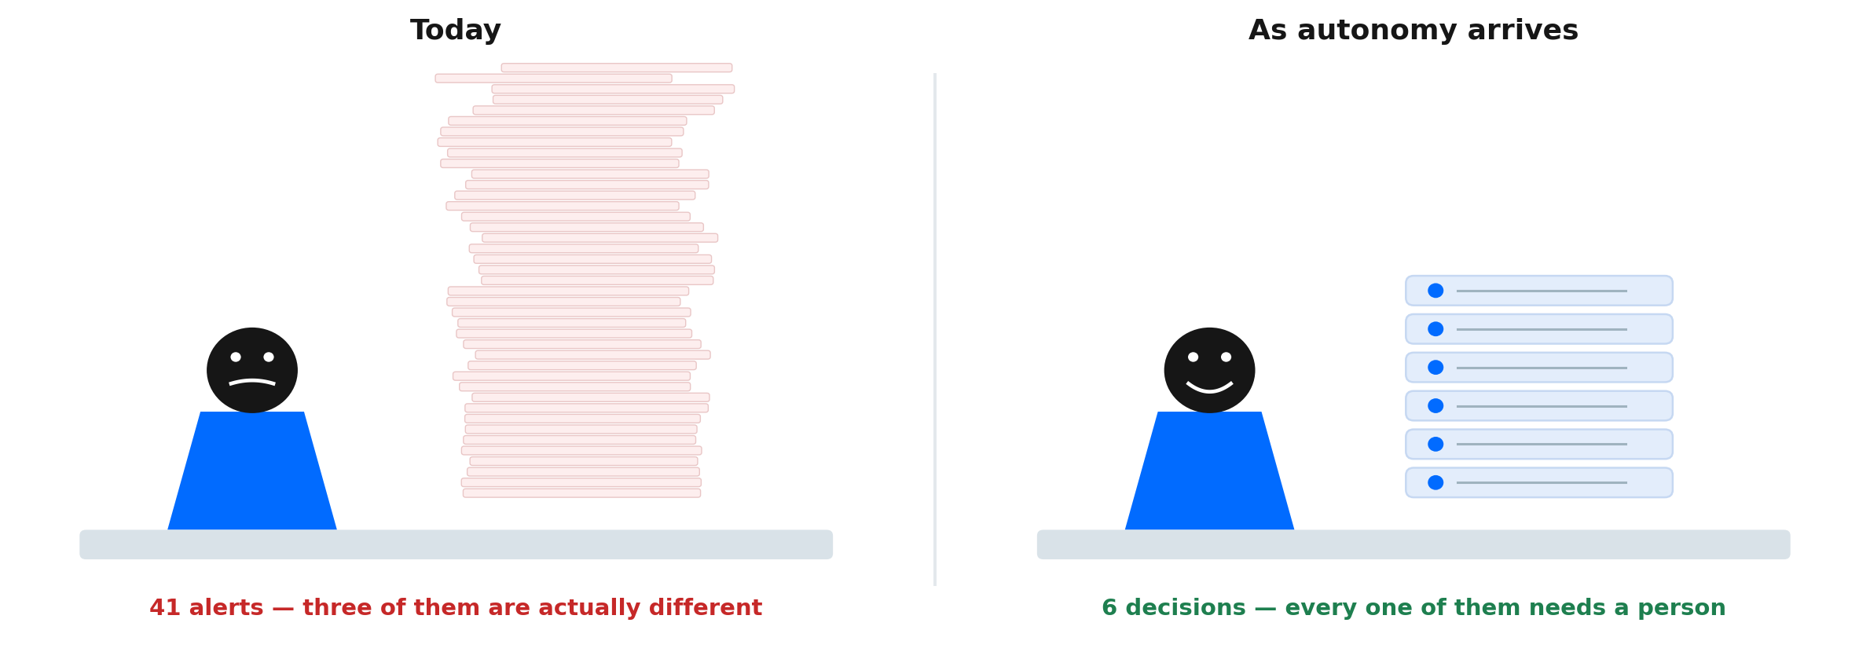
The Data Steward
A Data Steward's Monday morning
The same weekend of failures. A different queue at 08:30.
The pile does not disappear — the repeatable part of it does.
| Data Quality and Observability Platform
digna |
31
Notes:
Let this one land before you say anything. The room recognises the left side.
Then the point: the volume falls by an order of magnitude, and what is left is the part that actually needed a person.
Forty-one alerts, three real problems. Everybody in this room has had that Monday.

Slide 32
The Data Steward
The job gets more interesting, not smaller
Nothing here removes the Steward. It removes the part of the job nobody went into data to do.
What goes away
What it becomes
Reading the same alert for the fortieth time
Curating a library of approved resolution patterns
Chasing a partner about a feed that broke again
Deciding what an ambiguous value actually means
Re-running loads by hand at seven in the morning
Auditing the agent's decisions in aggregate, weekly
Explaining, once a quarter, why a number moved
Setting how much freedom each data product gets
Fewer tickets, more judgement. The repeatable work goes; the decisions stay.
| Data Quality and Observability Platform
digna |
32
Notes:
Be careful with tone here. There are Data Stewards in the room.
This is a promotion, not a replacement: the repeatable work goes, the judgement stays and grows.

Slide 33
The Data Steward
What the Data Steward becomes
The Steward stops fixing individual problems
and starts deciding how problems get fixed.
That is a more senior job than most stewards hold today — closer to policy than to operations — and it is the one organisations have been short of all along. Nobody is removed.
| Data Quality and Observability Platform
digna |
33
Notes:
Close the section here, and say it looking at the room.
There are Data Stewards in the audience. This is a promotion, and it is the senior version of the job they already do.
‘Nobody is removed. The work that scaled badly is.’

Slide 34
Honestly
What agents still do not solve
The limits have moved. They have not disappeared, and three of them are permanent.
It cannot invent a source of truth
It cannot define the purpose
It does not fix the upstream
Did the passenger actually board?
Is an infant on a lap a passenger?
A feed absorbed is a feed never repaired
the boarding scan is the record
a business decision, not a data one
the partner never feels the pain
No register knows
Which system is authoritative?
So every silent fix is still reported
and no amount of reasoning substitutes for one
somebody has to own that, in writing
the Steward hears about it regardless
Both copies can be wrong together
May history be restated?
Automation can hide a rotting source
reconciliation compares, it does not verify
the leg was reported to a regulator
which is the risk nobody prices in
A feed repaired silently forever never gets fixed at the source, so report every automatic fix.
| Data Quality and Observability Platform
digna |
34
Notes:
The honesty slide. Do not rush it — it is what stops this sounding like a pitch.
The third card is the one most decks omit: a feed silently repaired forever is a supplier problem you have paid to conceal.

Slide 35
Where this is
This is the direction digna is taking
We believe this is the future.
The first version reaches our customers in Q2 2027.
Our Data Quality and Observability platform is being built around exactly this — the trust gradient, the autonomy gate, the evidence trail and the pattern library.
| Data Quality and Observability Platform
digna |
35
Notes:
The one commitment in the talk. Say the date clearly and let it sit.
Everything before this slide was the argument; this is what digna is doing about it.
If anyone asks what ships first, point back to the 'Arriving next' column on the previous slide.

Slide 36
Can we let data fix itself?
Agents change the integration model, not just the tooling.
We will stop specifying how a reload happens and start specifying what may be reloaded, by whom, and without asking.
Precedent, reversibility and evidence — not confidence.
An agent that cannot name its source does not act. An action that cannot be undone does not run unattended.
The Data Steward curates patterns instead of chasing alerts.
Fewer tickets, more judgement, and a library that makes the hundredth fix free.
| Data Quality and Observability Platform
36
Notes:
Three sentences, then stop talking.
Leave the last one on screen while you take questions.

Slide 37
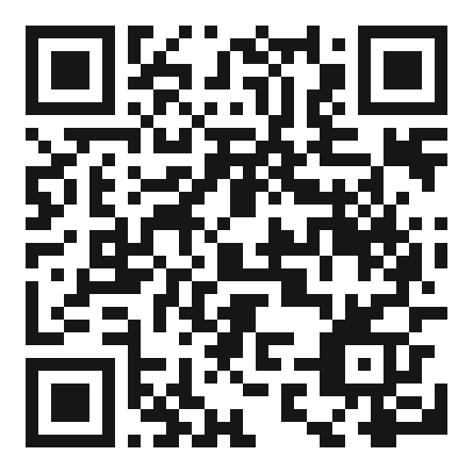
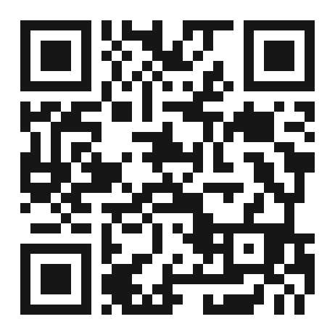
Questions
Happy to go deeper on any of the nine — or on what this looked like inside a bank.
Marcin Chudeusz
Co-Founder & CEO, digna
marcin.chudeusz@digna.ai www.digna.ai
Connect with me
on LinkedIn
Follow digna
on LinkedIn
| Data Quality and Observability Platform
digna |
37
Notes:
Q&A — after the 45 minutes\n\nLikely questions:\n\n• 'Is Alpenwing real?' — no, but every failure mode in it is. Say that early if anyone asks.\n\n• 'Isn't this just dbt tests?' — excellent, versioned, and still written by hand per table. The difference is who decides what to check.\n\n• 'How many false positives?' — depends on grouping and triage far more than on detection.\n\n• 'Does our data leave the environment?' — no. In-database, cloud or on-premise.\n\n• 'Which dimension should we start with?' — Completeness and Timeliness. Cheapest to turn on, fastest to show value.

Slide 38
